Slide 1

SPLITWISE
BY,
Aditya PRASANNA Handadi(50135734)
Karthick Moorthy(50136210)
cscI 531 – ADVANCED PROGRAMMING WITH JAVA

Slide 2
What our application does
Similar to “Splitwise” Application on SmartPhones – iOS and Android.
Keeps a track of expenses that others owe you or vice versa.
Can split the bill equally amongst everyone in the member of the group.

Slide 3
How different from existing applications
Simpler application than the Splitwise mobile App.
Existing Splitwise mobile App is for multiple platforms, where as our application is only a Desktop application.
Splitwise Mobile App can split the bill with specific set of people within the group, whereas our application can only split with one individual or the entire group.

Slide 4
List of features offered:
Register and Login, One account per group. For Common calculations.
Add any number of members to your group.
Add any expenses between the members of your group.
Show all the history of expenses recorded.
Dashboard individual share owed to or owed from the other members in the group.
Dashboard for calculating amount and expenses between any two individual in the group.

Slide 5
Components used:
Netbeans IDE
Java Swing Framework
JDK 1.8
MySQL Database
MySQL Workbench
Collections: List, Map, ArrayList and HashMap

Slide 6
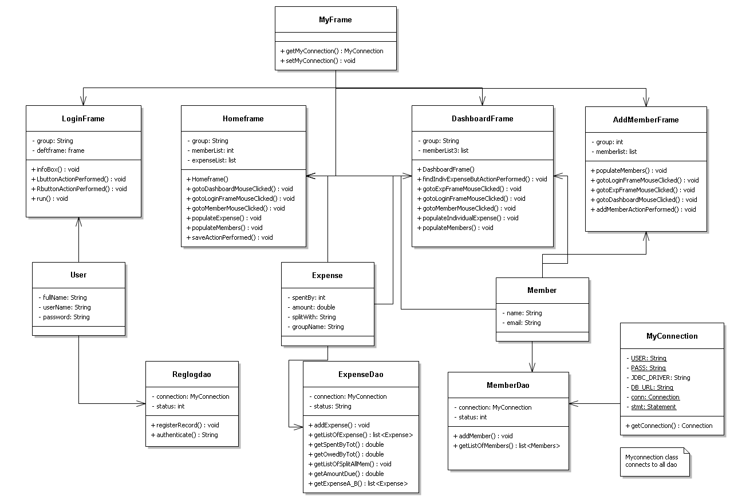
Class diagram

Slide 7
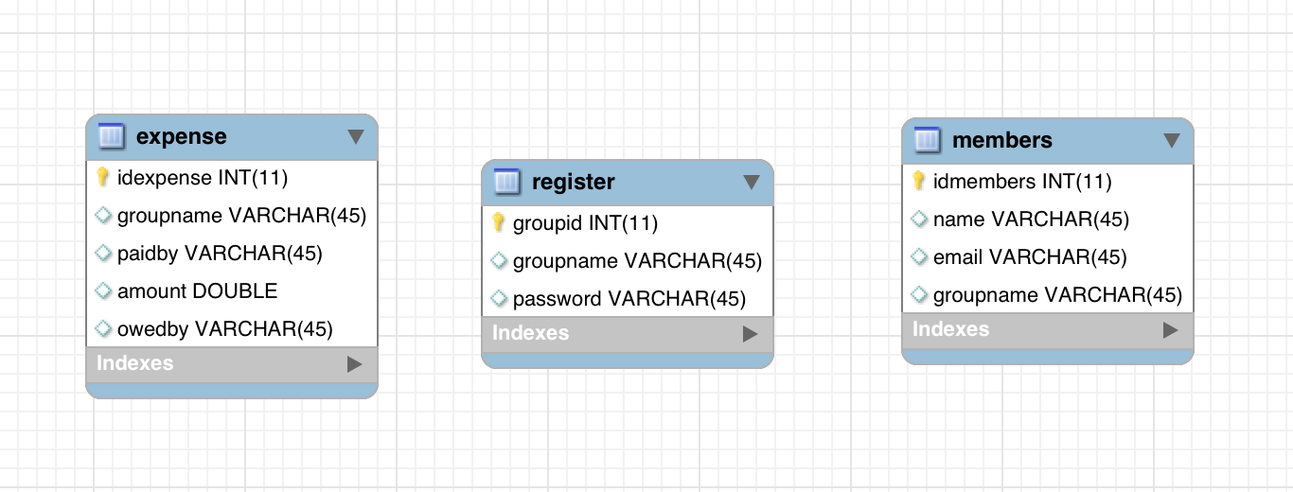
Database UML:

Slide 8
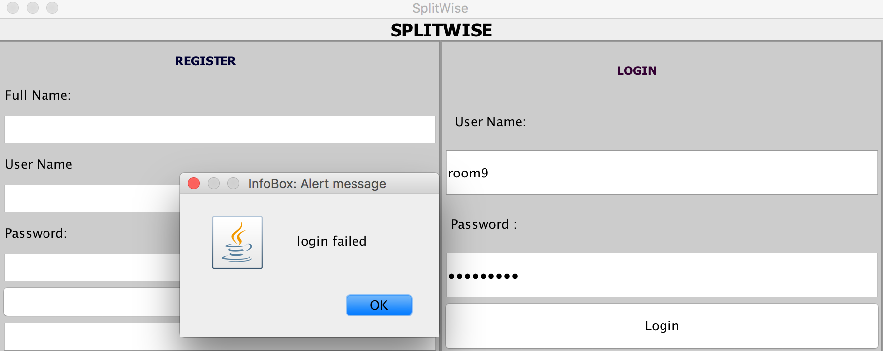
Feature description: 1. register & login

Slide 9
1.Register & login : description
Register to Login and Proceed. All fields mandatory
Login entering right credentials to proceed
If credentials not matched, error window pops – up. Retry to continue
If Registration Success, then message displayed. You can proceed to login only if registered.

Slide 10
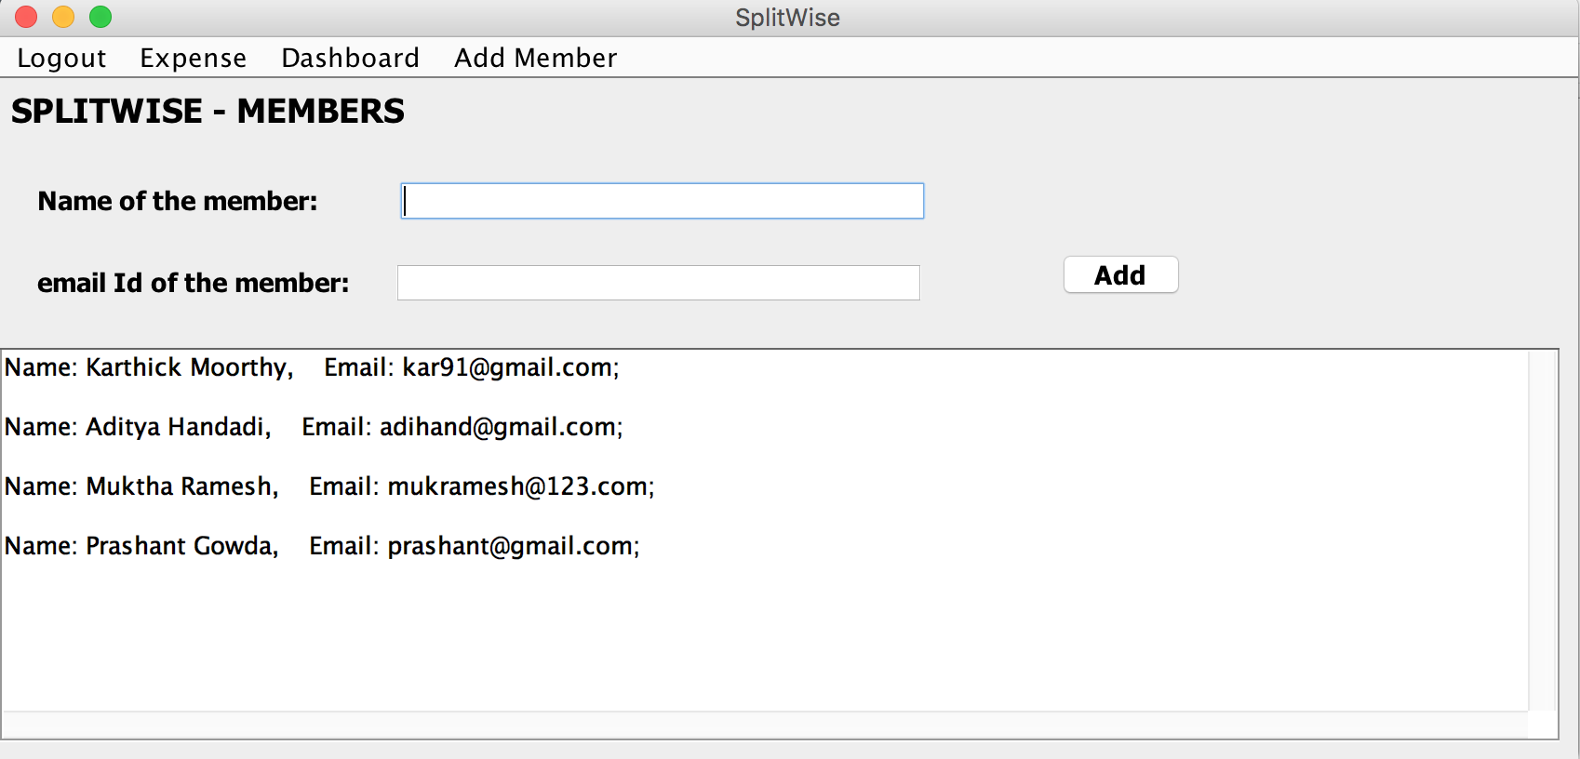
2. Add members to your group

Slide 11
2. Add members : description
Add any number of members to your group.
Name field mandatory
As soon as added, displays below with other list of existing members in the group if any
Records also saved in database for further calculations

Slide 12
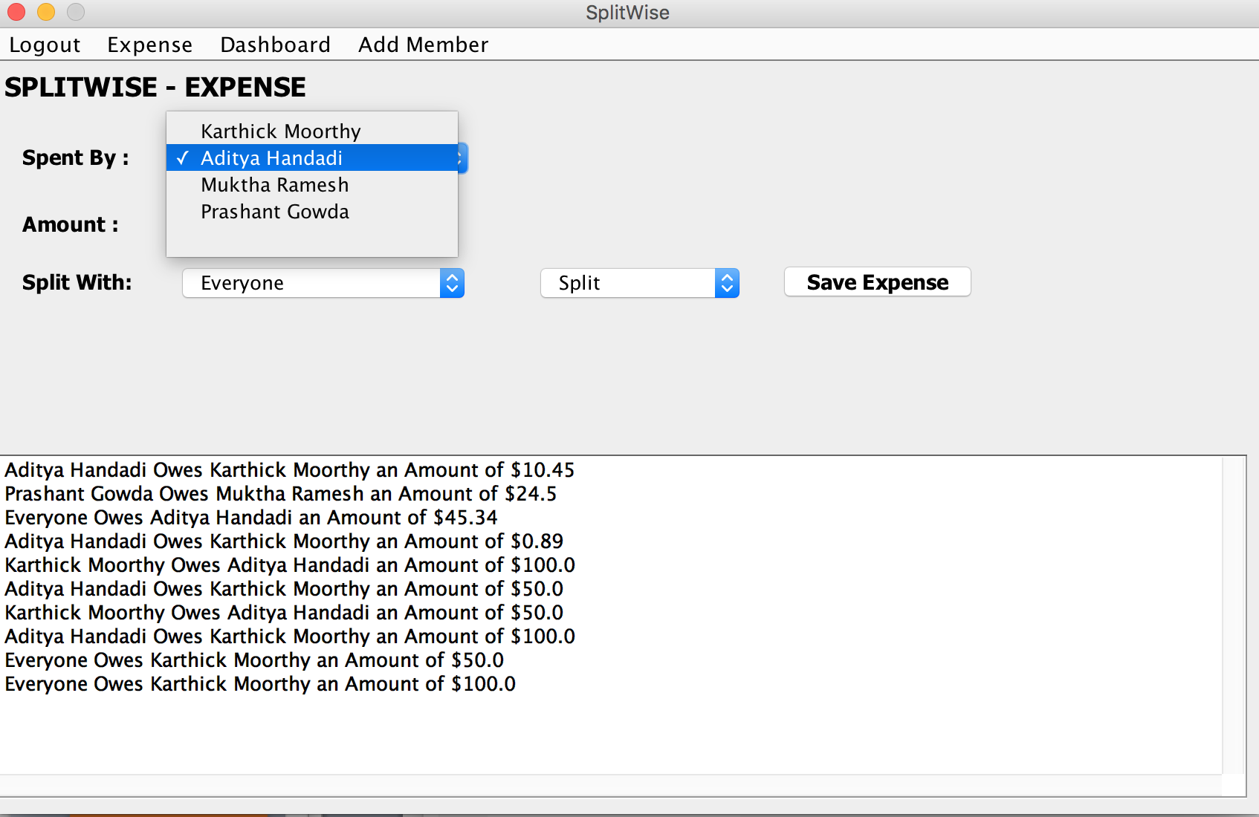
3. Add expense

Slide 13
3. Add expense : description
From DropDown select which member paid the full amount.
Enter how much amount to be split, (any precisions)
From another DropDown select who owes the full money or split money.
There is another DropDown with which you can either tell the system to split the bill Automatically, or if the second person owes the full amount
You can also choose to split with everyone, where by default the entire bill is split by everyone. [split type dropdown redundant]

Slide 14
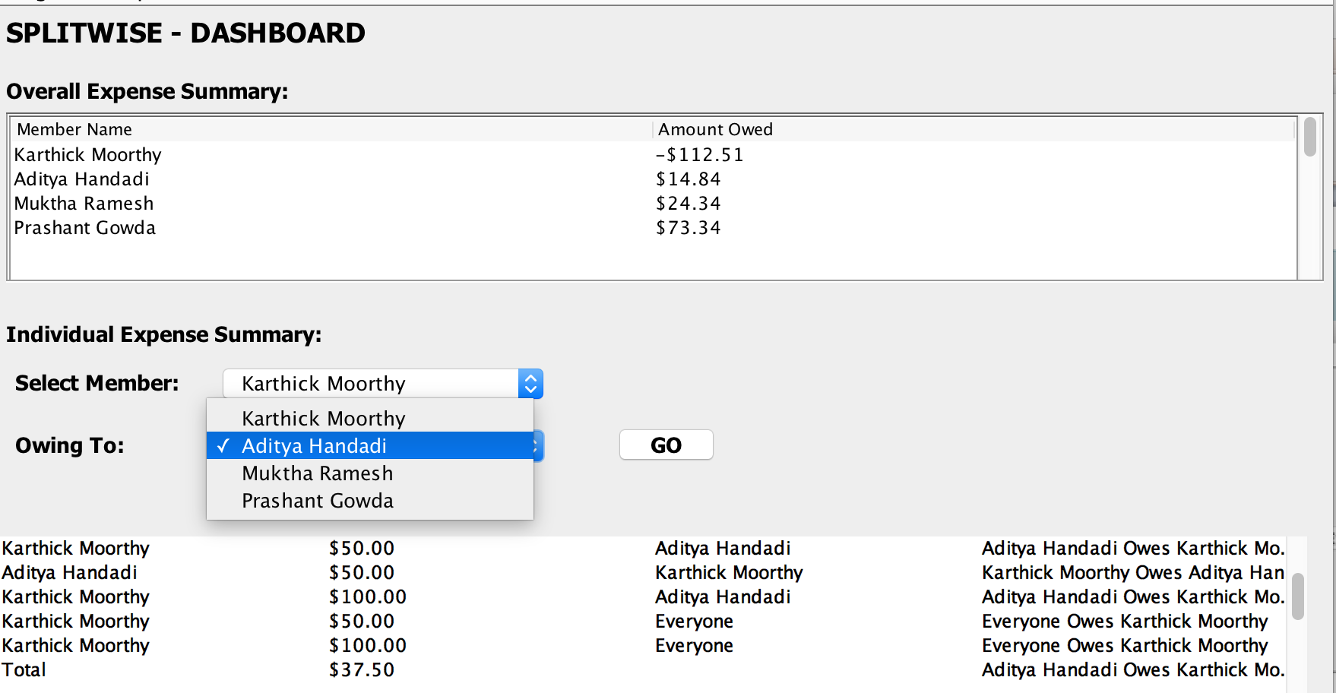
4. dashboard

Slide 15
4. Dashboard: description
Displays how much each individual owes to the group[auto populated]
Has another feature to view expenses between any 2 different individuals in the group.
Choose from dropdown between which 2 members you need to calculate expenses explicitly

Slide 16
conclusion
Understanding the Swing Framework and its ease of developing GUI applications
Understanding JDBC and different components involved to fetch multiple results and compute accordingly
As Swing framework serves the basis for other GUI applications like Android, learning was important since its scope is very broad

Slide 17
Future scope: What Is Good
Fast Calculations
Rigorously Tested and works precisely
Exceptions well handled
Very stable application

Slide 18
FUTURE SCOPE: What Could Have Been Better
Design Aspects
Packaging of Classes or Class Files
Less Database calls by using Lot of Java provided Data Structures and then calculate further.

Slide 19
THANK YOU

